Slide 1

Git at DHSC
A practical set-up guide

Slide 2


Why Git?
Git: distributed version control and source code management
Github: Internet hosting for projects that use Git, including easy-to-use user interface
What does this mean?
Distributed: can be stored in many places, so you have many back-ups and can’t accidentally lose work
Version control: ability to go back to earlier versions and label versions for reproducibility
Source code management: storing analysis scripts and documentation all together
Why does this help?
Internet hosting: files stored online, so not dependent on own servers
Easy to navigate and collaborate
Internet service and interface

Slide 3
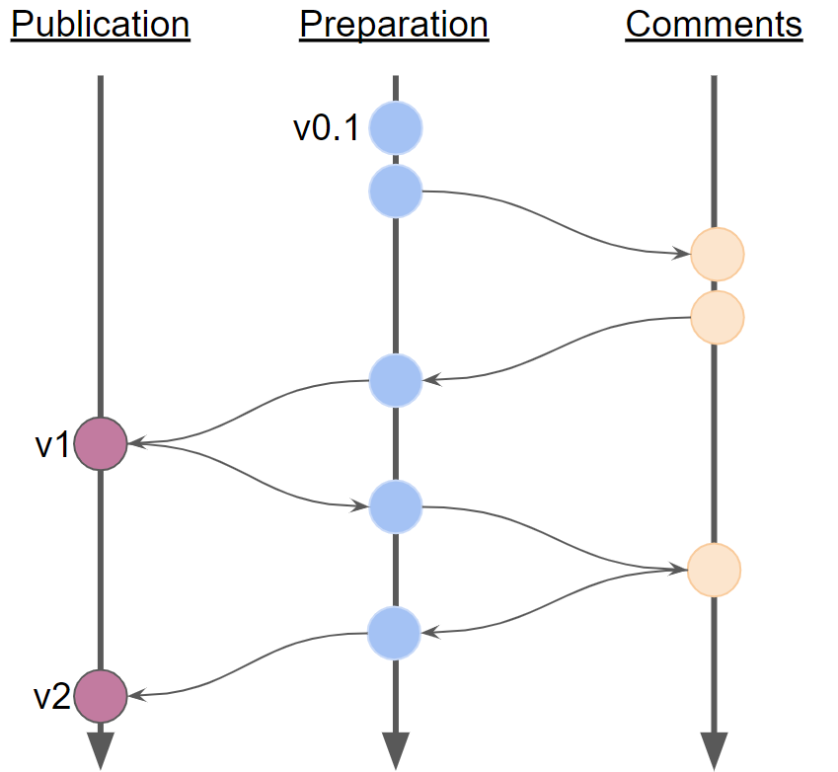
How does version control work?
Analysis_Version1
Analysis_Version2
Analysis_Version2_with_comments
Analysis_Version2_with_comments_JCN
Analysis_Version3
Analysis_Version3_final
Analysis_Publication_ready
If there are errors?
Analysis_Publication_fixes
Analysis_Publication_fixes_comments
Analysis_Publication_2
10 files to keep track of! Very easy to lose a file or to accidentally work on old versions
1 file, 10 versions, all tracked in 3 branches

Slide 4
Github: other features
Git on its own is powerful: Git + GitHub is a complete project management suite
Allows for private work as well as publishing
One of the best places to code in the open: The benefits of coding in the open - Government Digital Service (blog.gov.uk)
Reviewing
Easy interface for writing reviews and comments
Referring to specific lines of code
Issue tracker
Record bugs and ideas
Refer to them when adding new code, so they automatically link problem-solution
Automation
Can write a script and schedule it to run automatically
Limited minutes of runtime available for free
Webpages
GitHub Pages can take HTML produced by R Markdown and publish it to a website

Slide 5
Contents
Purpose of today: getting you set up with software and best practice.
1. Installing Git on your laptop
2. Getting set up on Github
3. Connecting Git to your RStudio
4. Setting up a project
5. Where to go next: learning and best practice

Slide 6
But I want to use Github for just one project RIGHT NOW!
You want to version control one project or receive QA from the DS team?
Set-up steps:
Create a Github account: www.github.com
E-mail DataScience@dhsc.gov.uk to be added to DHSC Data Science (github.com) team space on Github

Slide 7
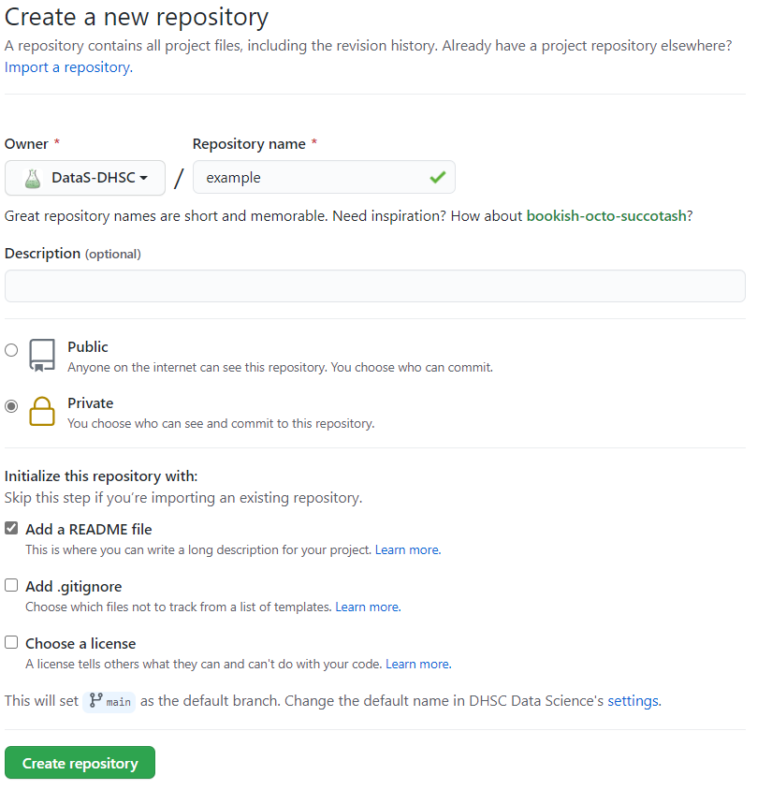
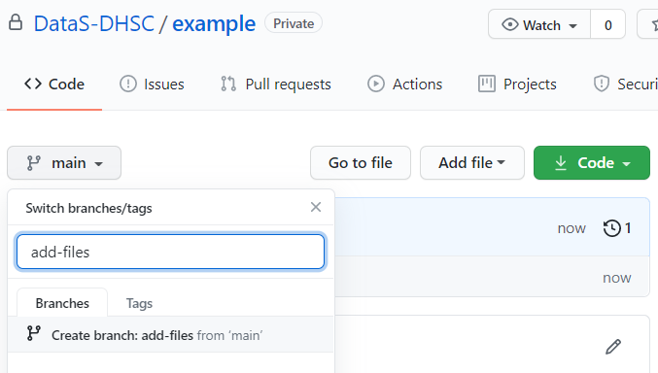
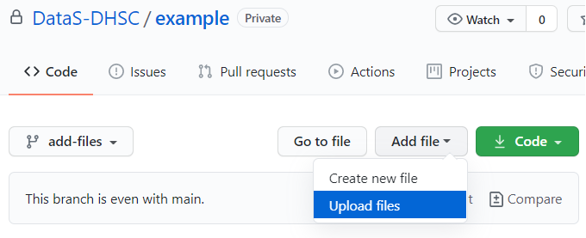

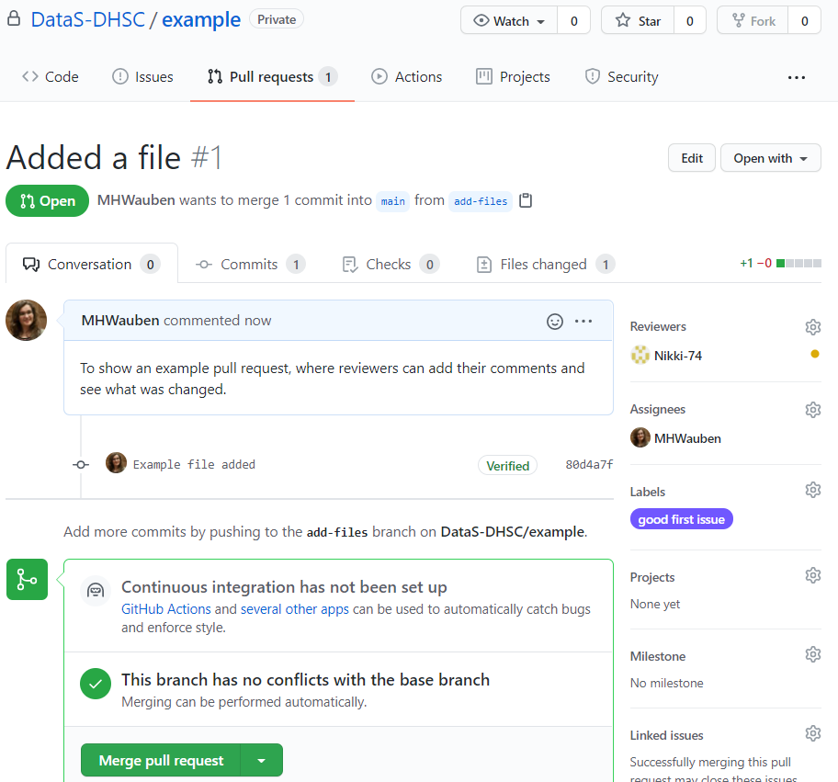
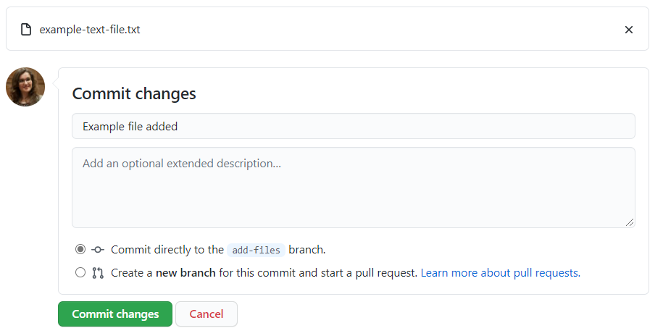
Bare-bones Github project review
Create a new repository with a readME file
Create a new branch
Upload your files
Create a ‘pull request’ for review

Slide 8
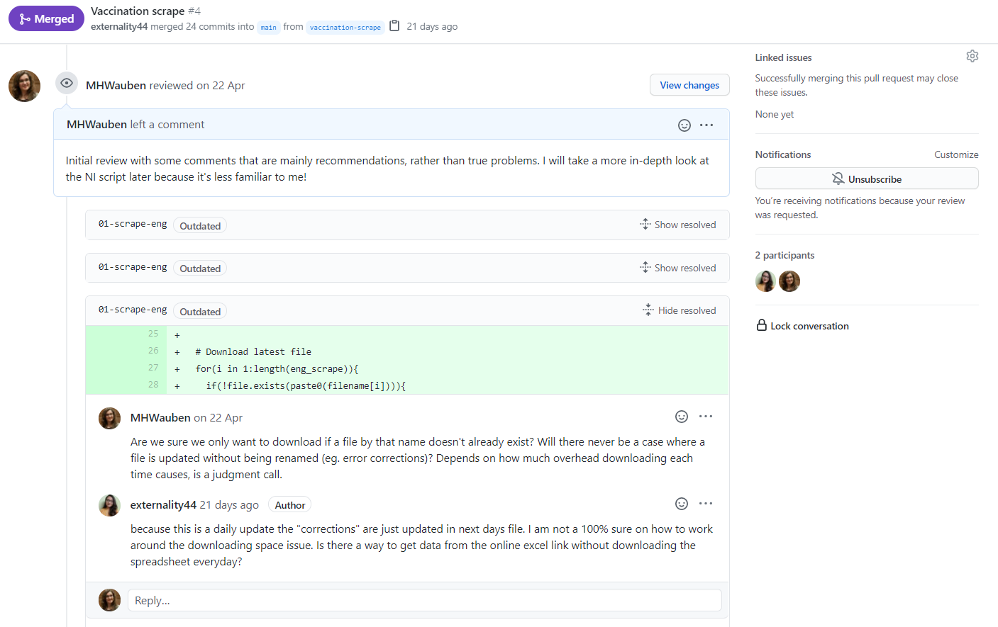
Reviews: a QA conversation, documented

Slide 9
Git and files
Git works best for text files
Code scripts (.R, .Rmd, .py, .sh, anything!)
Documentation (.md or .txt files)
Temporary, small, or dummy data storage (.csv)
Or for files you want to version control as a whole
Images (.png)
You can use it for other types of files, but it will be harder to review changes in them and so we do not recommend this
Spreadsheets with small iterations (.xlsx)
PowerBI (.pbix)

Slide 10
Contents
Purpose of today: getting you set up with software and best practice.
1. Installing Git on your laptop
2. Getting set up on Github
3. Connecting Git to your RStudio
4. Setting up a project
5. Where to go next: learning and best practice
One-time setup

Slide 11
Installing Git
Fill in Developer Account application form
Send the completed form to us
Await approval
Download Git installer
Run Git installer
Analyst Developer Account and Software Request Form v0.1 - The Analyst Hub - DH eXchange (kahootz.com)
DataScience@dhsc.gov.uk
Git for Windows
No need to change installation defaults
Takes up to a day
Git location
Write down folder path to git.exe file for later

Slide 12
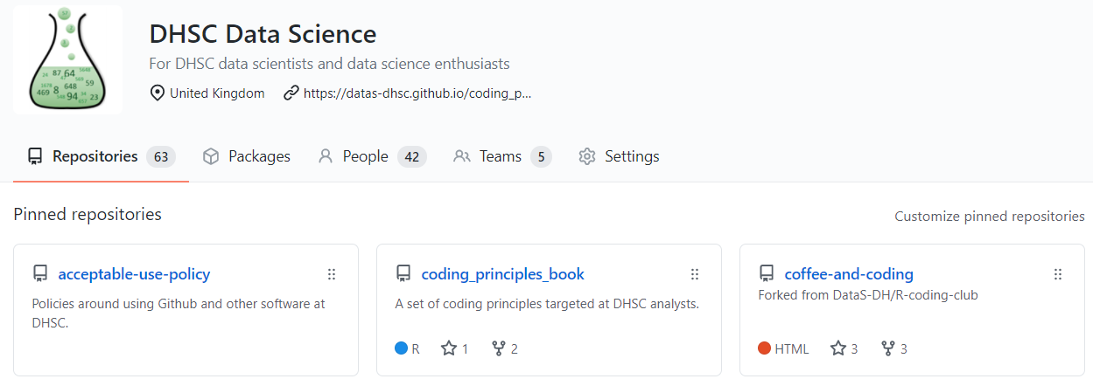
Setting up Github
Create a Github Account
Set up two-factor authentication
Ask to join DataS-DHSC organisation
GitHub
Configuring two-factor authentication - GitHub Docs
E-mail Nikki Shorrock, Alex Betts, Martine Wauben, or Jamie Fraser

Slide 13

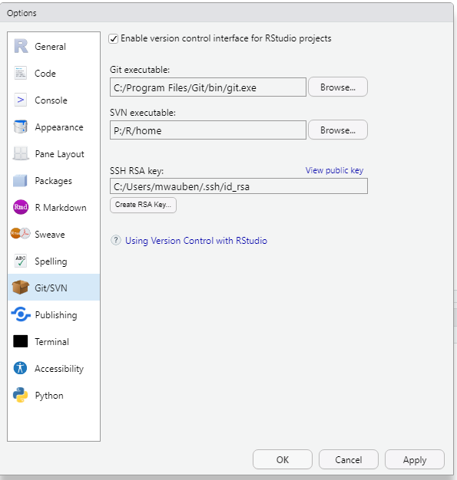
Git & RStudio
Install RStudio
Software Centre (if not there, request from Atos)
Point RStudio to Git
Tools > Global Options > Git / SVN
Create SSH RSA key
Copy key to clipboard
Add SSH key to Github
Settings > SSH and GPG keys > New SSH key

Slide 14
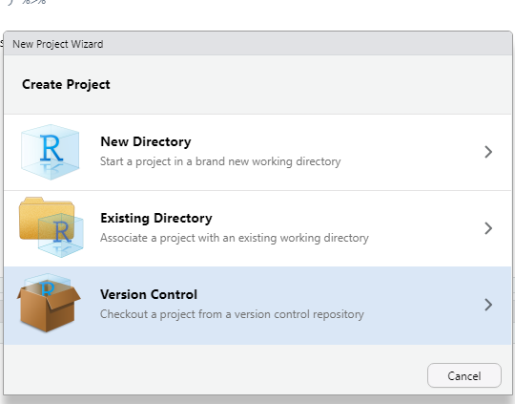
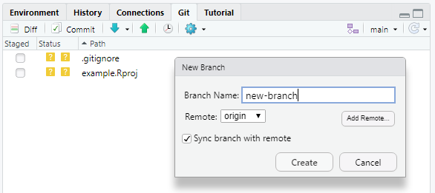
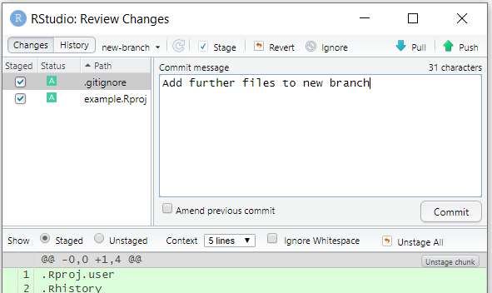
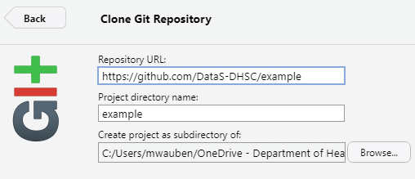

Setting up a project in RStudio
Create a new repository with a readME file
Create a new R Project in its image
Create a new branch and add commits (& push!)
Create a ‘pull request’ for review. After review, merge

Slide 15
Where to go next
Best practice
Quality Assurance of Code for Analysis and Research — Quality Assurance of Code for Analysis and Research (best-practice-and-impact.github.io)
DataS-DHSC/acceptable-use-policy: Policies around using Github and other software at DHSC.
DataS-DHSC/coding_principles_book: A set of coding principles targeted at DHSC analysts. (github.com)
Learning Git
Git training by RStudio: look out for the invite!
GitHub Guides
Learn Git | Codecademy

Slide 16
Process re-cap
Install Git
Request developer account
Download Git
Set up Github
Create GH account
Get added to DataS-DHSC organisation
Set up RStudio
Point RStudio to Git
Set up SSH keys
Set up code
Create GH repository
Clone repository to laptop

